Slide 1



20 POWER BI TIPS…
IN 20 MINUTES!
Matt Lakin
@datalakin
in/mattlakin
mattdatalakin.com

Slide 2




Feedback
Any questions?
@datalakin
/in/mattlakin
datalakin
mattdatalakin.com
meetup.com/newcastle-pug

Slide 3
Tip # - Power Query table navigation
Show how to easily navigate across a table using Ctrl + G
Show how to look at single row data in columnar format

Slide 4
Tip # - ChooseColumns vs RemoveColumns
Show difference between
Choose Columns
Remove Columns
Remove Other Columns
Choose Columns & Remove Other Columns are best practice because they don’t create dependencies on unwanted columns, but they do create dependencies on wanted columns

Slide 5
Tip # - Power Query table functions
Show how to use the column name transformer to iterate over columns
Table with lots of columns that are named badly
- Solutions:
a) Go back to source and rename
b) Rename manually
c) Table.TransformColumnNames
- Show how to implement the function
- Show how to change the function depending on needs

Slide 6
Tip # - Power Query filter column
Show how to filter a column by right clicking on a specific cell

Slide 7
Tip # - Power Query parameters!
Show how to add parameters in Power Query for filtering
Show how to add parameters into M code
Show how to change parameters
Show how to change parameters in Power BI Service
Show how to add to deployment pipelines

Slide 8
Tip # - Power Query quick access
Show how to add features to the quick access pane (e.g. Advanced Editor)

Slide 9
Tip # - Power Query shortcuts
Add quotes or brackets – Shift + “” or ( or {
Comment/uncomment
Line – Ctrl + /
Block – Alt + Shift + A
Zoom in/out – Ctrl + Shift + +/-

Slide 10
Tip # - Date tables
Discuss options for creating date tables
From database/source
CALENDARAUTO()
M Query
Bravo

Slide 11
Tip # - Tabular Editor scripting
Introduction into scripting in Tabular Editor
Best Practice Analyzer

Slide 12
Tip # - Calculation groups
Show how to add calculation group and calculation item
Show example of Origin/Destination Airport relationships

Slide 13
Tip # - Table visual tips
Discuss options for creating data dictionary
Automatic column width
Manual drag – fix column widths
Dynamic measure
Shift <- / -> while column is selected
Show how to change global font size in a table visual

Slide 14
Tip # - Dynamic formatting
Dynamic format type
Calculation item

Slide 15
Tip # - Conditional formatting icons
UNICHAR
Custom Icons

Slide 16
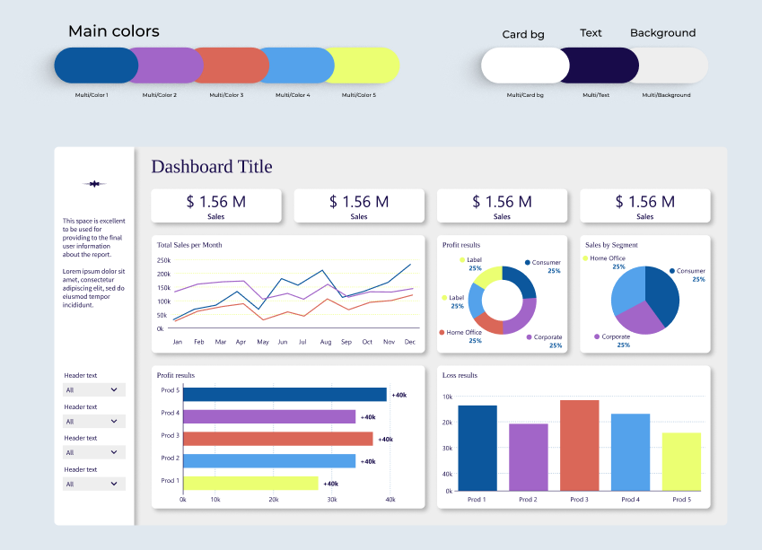
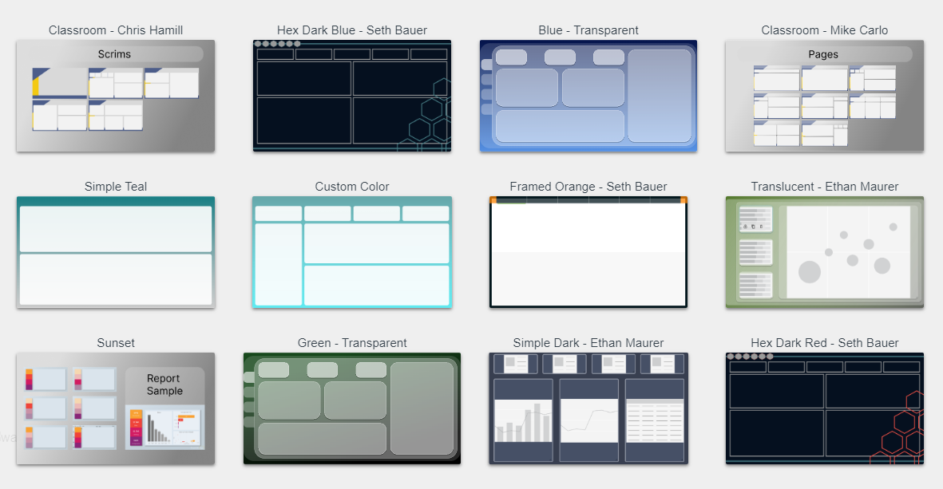
Tip # - Theme Generators!
Notes:
Show Manual way of using and editing themes – Power BI Desktop
Show Power BI Tips
- Gallery - download as .pbip
- Wireframes
- Pallete options – collab with Coolers
- Icons
Show Figma Theme Generator by BIBB
Point to other theme generators

Slide 17
Tip # - Visual shortcuts
Clear selection using space/enter
Lock tooltip - Ctrl + Shift + F10
Group visuals – Ctrl +G

Slide 18
Tip # - Table view shortcuts
Expand tables – Alt + Shift + 9
Expand tables – Alt + Shift + 1

Slide 19
Tip # - Measure shortcuts
Select same words within measure and replace – Ctrl + Shift + L

Slide 20
Tip # - Bar chart bullet
Show how to use error bars to add targets to bar charts

Slide 21
Tip # - Dynamic title/subtitle
Show how to use add dynamic title/subtitle to a visual – advanced card

Slide 22
Tip # - Data dictionary
Discuss options for creating data dictionary
DAXQuery View
DAXStudio

Slide 23



WHO’S THIS GUY?

Slide 24
To do
Screenshots
Power BI Pro / Fabric trial

Slide 25
Tips
Error handling – how to use custom error handling & messages
Query folding & diagnostics – sharepoint list
Themes! + Theme generators + Background images
Load testing
Using bars as legends/filters
Tabular editor – scripting
Tabular editor – BPA
Performance Analyzer
Calculation groups – use cases!
– flick between logic – SUM/AVG/MAX/MIN or time logic – YTD/MTD/WTD/TOTAL
- flick between different relationships
- flick between different formatting
- flick between conditional formatting options (e.g. show lowest 5, highest 5 etc)
Keyboard shortcuts
Accessibility testing
IsAvailableInMdx
Create your own data dictionary!
Power Query – row info in column format, Ctrl + G to pick column
Power Query – filter by right clicking on cell value
UNICHAR
Expanded tables
Psuedo table in X functions
Table visual – column header resizing through shift left/right and through a measure
Standardizing report dimensions with .pbip and pbi-tools
- column width not available in desktop UI
https://bengribaudo.com/blog/2018/05/18/4447/automating-column-name-renames
ALM Toolkit
Bravo – create dates, unrefrerenced columns etc.

